Slide 1
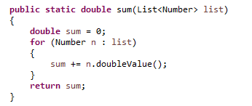
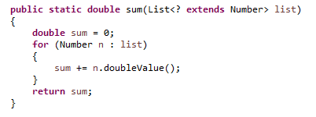
Java Generics Upper Bounded Wildcard
Upper bounded wildcards are used to relax the restriction on the type of variable in a method. Suppose we want to write a method that will return the sum of numbers in the list, so our implementation will be something like this.
Now the problem with above implementation is that it won’t work with List of Integers or Doubles because we know that List<Integer> and List<Double> are not related.
this is when upper bounded wildcard is helpful.
We can use generics wildcard with extends keyword and the upper bound class or interface that will allow us to pass argument of upper bound or it’s subclasses types.

